Slide 1
DATE Sept 14
Clara
Citizenship 9
Insert some kind of cool picture here

Slide 2
TABLE OF CONTENTS
TABLE OF CONTENTS
WHERE
1
2
3
4
Personal
Community
Global
Aspirational

Slide 3
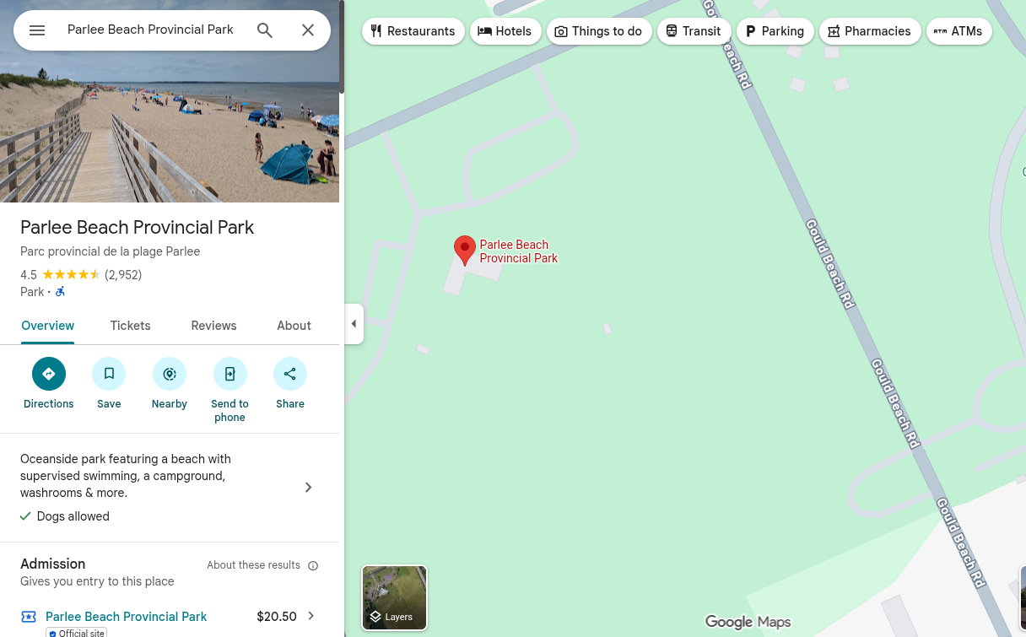
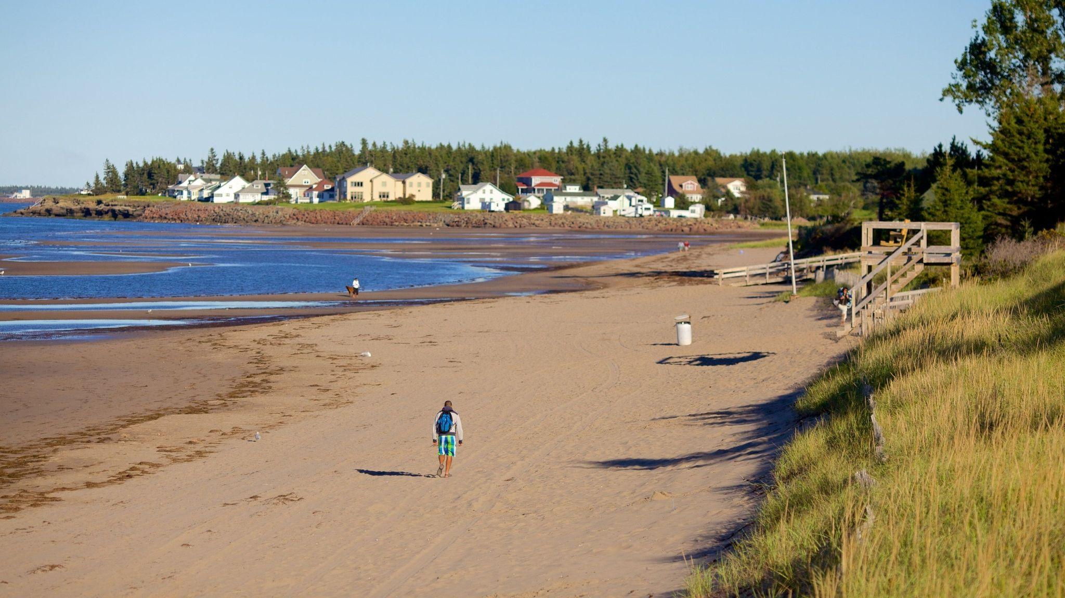
The Personal Place
Cit 9 WHERE
MAP SCREENSHOT (from Bing Maps) | Reflection: Write about a personal place that holds significance for you. Tell the story of the place! Guiding Questions: In a second section, describe how your personal perspective shapes the way you see and feel about this place. What stories or memories are tied to this specific location? Parlee Beach Shediac NB. Parlee Beach Shediac is very important to me. Every summer I go here with 3 other familys, and we have been going since i was around 2. These 3 other familys i don’t get to see alot the rest of the year. So the 4 days that we speed in Parlee is very special. | IMAGE
Notes:
The Personal Place
Reflection: Write a paragraph about a personal place that holds significance for you.
Guiding Questions:: In a second section, describe how your personal perspective shapes the way you see and feel about this place. What stories or memories are tied to this specific location?

Slide 4
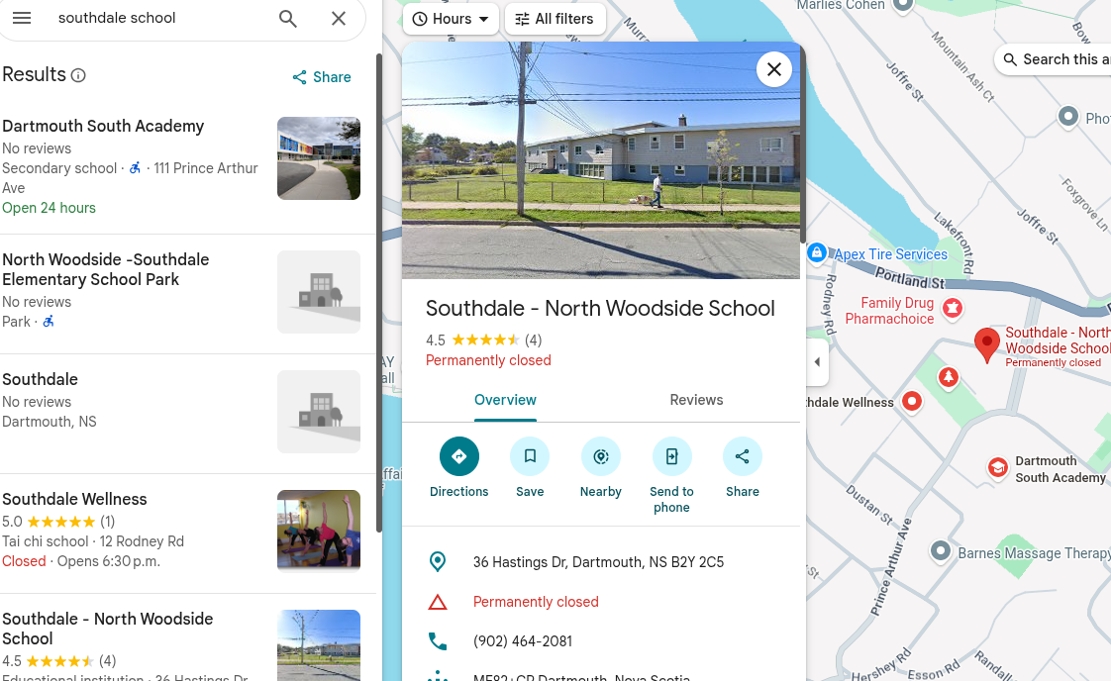
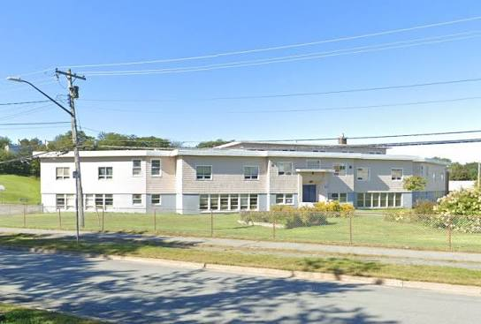
The Community Place
Cit 9 WHERE
MAP SCREENSHOT | Reflection: Write about a significant place in our local community. Tell the story of the place! Who owns it? Why do you like it? Describe something that happened there that you remember. Southdale school. Southdale was my first school that I ever went to. Its very important to me because it is the pace i started my academic journey. I went there for grade primary with a very close friend that i am still close to to the day. I also used to play at the playground down there all the time when i was younger, and i have very fond memories from then. | IMAGE
Notes:
Reflection: Write about a significant place in our local community. Tell the story of the place! Who owns it? Why do you like it? Describe something that happened there that you remember.

Slide 5
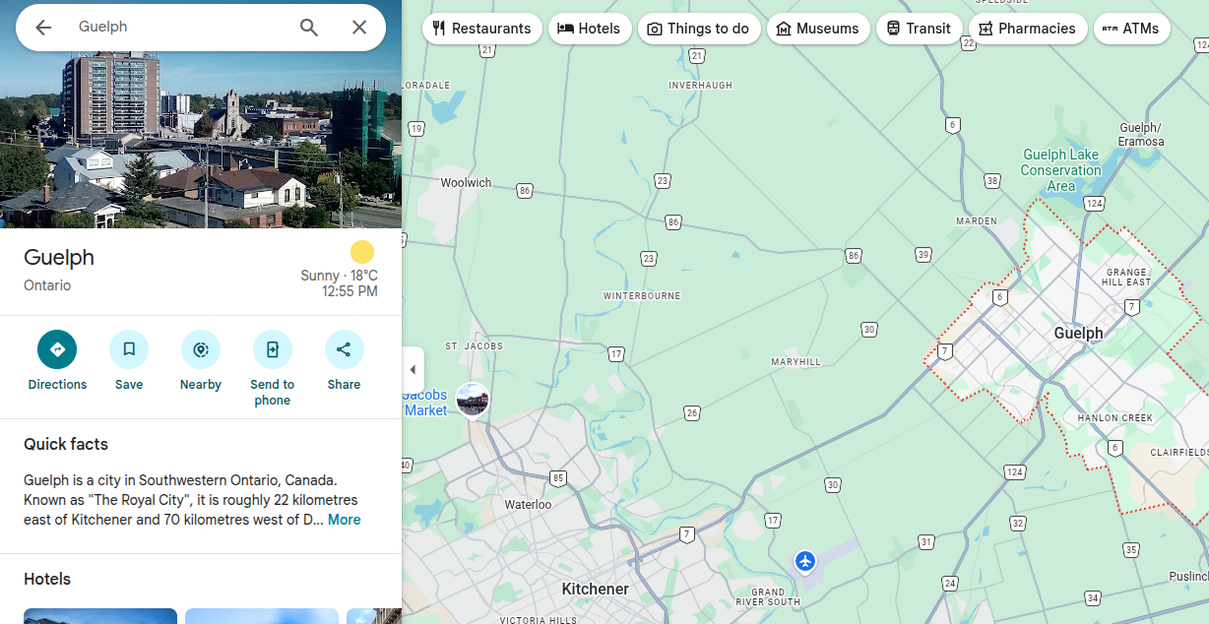
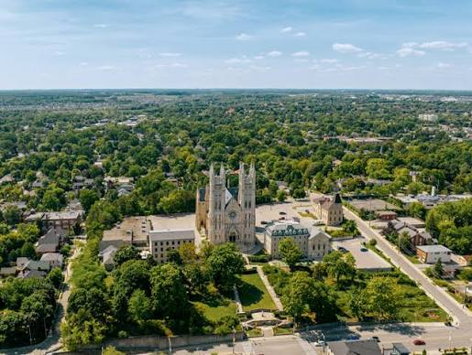
The Global Place
Cit 9 WHERE
MAP SCREENSHOT | Reflection: Write a story about a place in the world that is part of your family's story. Guiding Questions: Tell the story of how you and/or your family are connected to this place. What traditions or values from this place have been passed down to you? How does this connect to your cultural identity, including things you do and who you are? Guelph Ontario Guelph is a place that i don’t remember going to, bur its actually where i was born! I think this place is important to me my parents had lived in Guelph for many years, and made a home. But when they had me they moved us back to Halifax before i even turned 1, so that we could be close to my family. So thats why Guelph is important to me. | IMAGE
Notes:
Reflection: Write a story about a place in the world that is part of your family's story.
Guiding Questions: Tell the story of how you and/or your family are connected to this place.
What traditions or values from this place have been passed down to you?
How does this connect to your cultural identity, including things you do and who you are?

Slide 6
The Aspirational Place
Cit 9 WHERE
MAP SCREENSHOT | Reflection: Write a story about a place you have never been to but dream of visiting. Guiding Questions: What draws you to this place? What do you hope to learn or experience there? How does this place fit into your hopes for the future? Greece Ive always wanted to go to Greece, my parents went there for there honey moon and said it was really beautiful, and I have a few friends there that said they loved it and would totally go back, so thats why I want to go there. | IMAGE
Notes:
Reflection: Write a story about a place in the world that is part of your family's story.
Guiding Questions: What draws you to this place? What do you hope to learn or experience there? How does this place fit into your hopes for the future?

Slide 7
The Aspirational Place
Cit 9 WHERE
Soundtrack of your life | Post the youtube link here https://www.youtube.com/watch?v=m2uTFF_3MaA Yellow submarine-The Beatles. | What’s the story on the song? Write here! I chose this song beacause when i wasyounger and didn’t have a phone i had this really old ipod that belonged to my grampy. But the thing is the ipod was broken so there was really only around 5 songs i could listen to, and one of the was Yellow Submarine. This song was my favourite one out of all of them so i was constantly listening to it on repeat. So thats why i chose this song.
Notes:
Reflection: Write a story about a place in the world that is part of your family's story.
Guiding Questions: What draws you to this place? What do you hope to learn or experience there? How does this place fit into your hopes for the future?

Slide 8
THANK YOU

